Slide 1

Artificial Intelligence and Machine Learning are transforming the manufacturing industry. According to the report released by World Economic Forum, these technologies will play significant roles in the fourth industrial revolution. Major areas which can be benefited from this are:
Maintenance Department
Production Department
Supply Chain Department
Deep learning has been proven to be superior in detecting and localizing defects using imagery data which could significantly improve the production efficiency in the manufacturing industry.
Great Example from LandingAI: https://landing.ai/defect-detection/
Reference: https://www.cio.com/article/3302797/how-ai-is-revolutionizing-manufacturing.html

Slide 2
In this case study, we will assume that you work as an AI/ML consultant.
You have been hired by a steel manufacturing company in San Diego and you have been tasked to automate the process of detecting and localizing defects found in Steel manufacturing.
Detecting defects would help in improving the quality of manufacturing as well as in reducing the waste due to production defects.
The team has collected images of steel surfaces and have approached you to develop a model that could detect and localize defects in real-time.
You have been provided with 12600 images that contain 4 types of defects, along with their location in the steel surface.

Slide 3
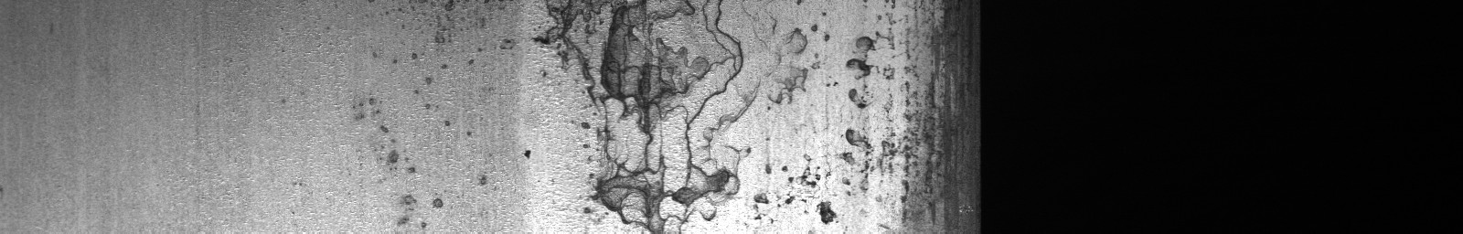
LAYERED DEEP LEARNING PIPELINE TO PERFORM CLASSIFICATION & SEGMENTATION
RESUNET SEGMENTATION MODEL
DEFECT DETECTED
INPUT IMAGES
FROM MANUFACTURING LINE OR MAINTENANCE DEPARTMENT
DETECT DEFECT LOCATION ON THE PIXEL LEVEL
RESNET DEEP LEARNING CLASSIFIER MODEL
END
DEFECT FREE

Slide 4
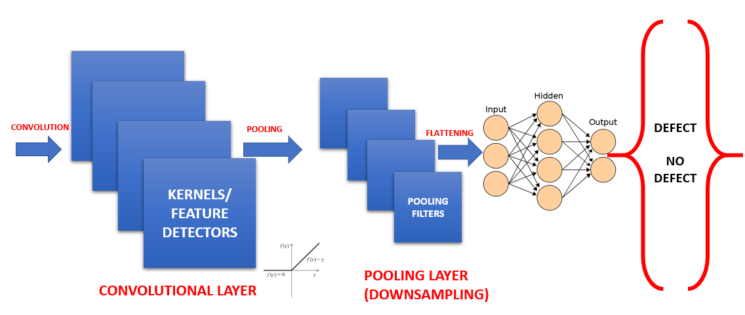
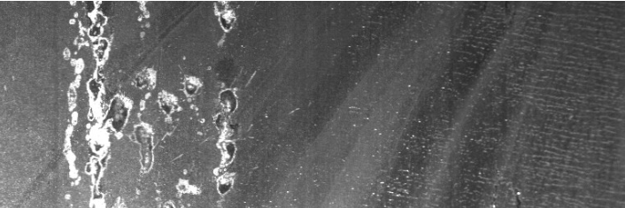
CONVOLUTIONAL NEURAL NETWORKS (REVIEW)
The first CNN layers are used to extract high level general features.
The last couple of layers are used to perform classification (on a specific task).
Local respective fields scan the image first searching for simple shapes such as edges/lines
These edges are then picked up by the subsequent layer to form more complex features.

Slide 5
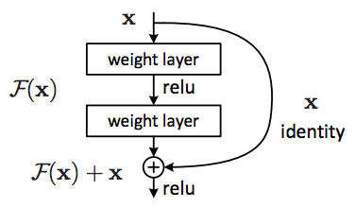
RESNET (RESIDUAL NETWORK) (REVIEW)
As CNNs grow deeper, vanishing gradient tend to occur which negatively impact network performance.
Vanishing gradient problem occurs when the gradient is back-propagated to earlier layers which results in a very small gradient.
Residual Neural Network includes “skip connection” feature which enables training of 152 layers without vanishing gradient issues.
Resnet works by adding “identity mappings” on top of the CNN.
ImageNet contains 11 million images and 11,000 categories.
ImageNet is used to train ResNet deep network.

Slide 6
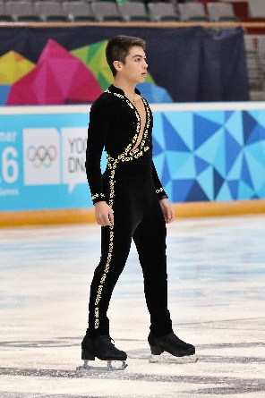
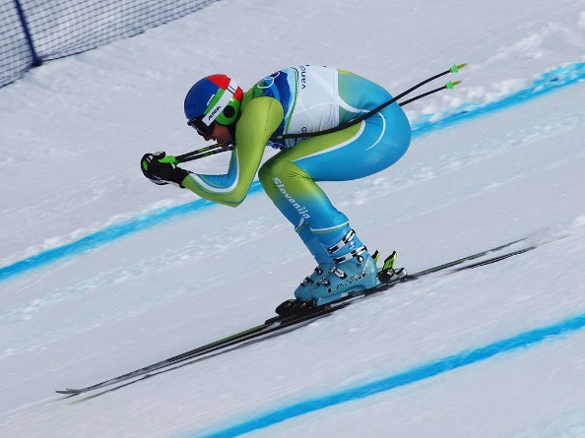
TRANSFER LEARNING? (REVIEW)
Transfer learning is a machine learning technique in which a network that has been trained to perform a specific task is being reused (repurposed) as a starting point for another similar task.
Transfer learning is widely used since starting from a pre-trained models can dramatically reduce the computational time required if training is performed from scratch.
KNOWLEDGE TRANSFER
Photo Credit: https://commons.wikimedia.org/wiki/File:Lillehammer_2016_-_Figure_Skating_Men_Short_Program_-_Camden_Pulkinen_2.jpg
Photo Credit: https://commons.wikimedia.org/wiki/Alpine_skiing#/media/File:Andrej_%C5%A0porn_at_the_2010_Winter_Olympic_downhill.jpg
Citations: Olga Russakovsky, Jia Deng, Hao Su, Jonathan Krause, Sanjeev Satheesh, Sean Ma, Zhiheng Huang, Andrej Karpathy, Aditya Khosla, Michael Bernstein, Alexander C. Berg and Li Fei-Fei.
ImageNet Large Scale Visual Recognition Challenge. arXiv:1409.0575, 2014.

Slide 7
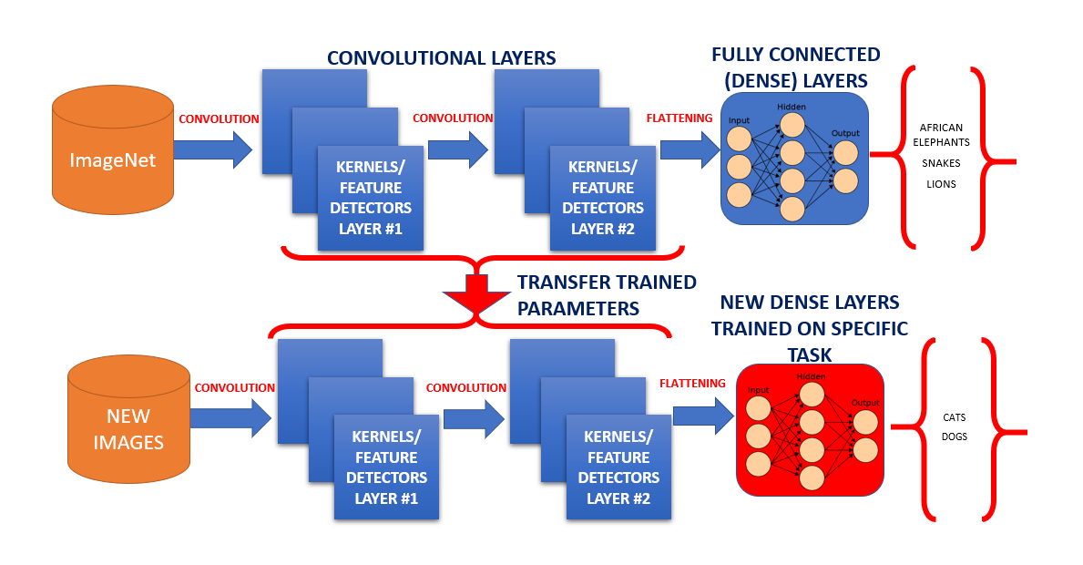
TRANSFER LEARNING PROCESS (REVIEW)

Slide 8
TRANSFER LEARNING TRAINING STRATEGIES
Strategy #1 Steps:
Freeze the trained CNN network weights from the first layers.
Only train the newly added dense layers (with randomly initialized weights).
Strategy #2 Steps:
Initialize the CNN network with the pre-trained weights
Retrain the entire CNN network while setting the learning rate to be very small, this is critical to ensure that you do not aggressively change the trained weights.
Transfer learning advantages are:
Provides fast training progress, you don’t have to start from scratch using randomly initialized weights
You can use small training dataset to achieve incredible results

Slide 9


WHAT IS IMAGE SEGMENTATION?
The goal of image segmentation is to understand and extract information from images at the pixel-level.
Image Segmentation can be used for object recognition and localization which offers tremendous value in many applications such as medical imaging and self-driving cars etc.
The goal of image segmentation is to train a neural network to produce pixel-wise mask of the image.
Modern image segmentation techniques are based on deep learning approach which makes use of common architectures such as CNN, FCNs (Fully Convolution Networks) and Deep Encoders-Decoders.
You will be using ResUNet architecture to solve the current task.
ResUNet

Slide 10
WHAT IS IMAGE SEGMENTATION?
Recall when we applied CNN for image classification problems? We had to convert the image into a vector and possibly add a classification head at the end.
However, in case of Unet, we convert (encode) the image into a vector followed by up sampling (decode) it back again into an image.
In case of Unet, the input and output have the same size so the size of the image is preserved.
For classical CNNs: they are generally used when the entire image is needed to be classified as a class label.
For Unet: pixel level classification is performed.
U-net formulates a loss function for every pixel in the input image.
Softmax function is applied to every pixel which makes the segmentation problem works as a classification problem where classification is performed on every pixel of the image.
Great article by Aditi Mittal: https://towardsdatascience.com/introduction-to-u-net-and-res-net-for-image-segmentation-9afcb432ee2f

Slide 11
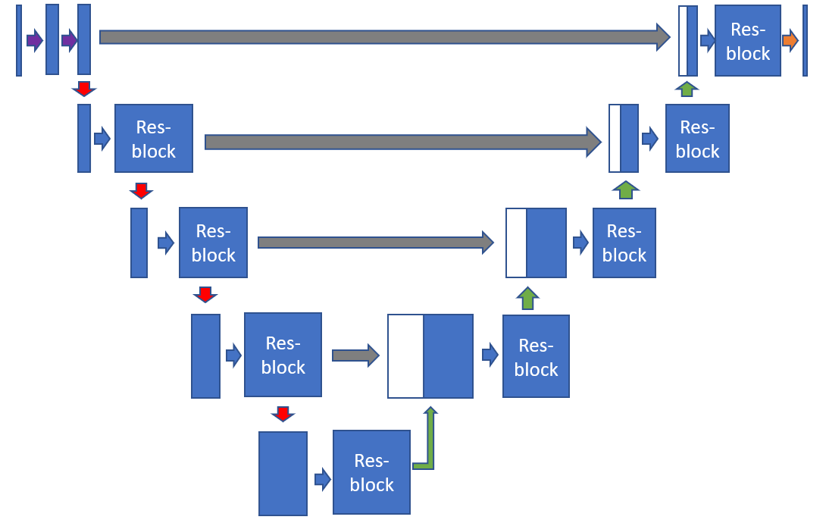
RESUNET
ResUNet architecture combines UNet backbone architecture with residual blocks to overcome the vanishing gradients problems present in deep architectures.
Unet architecture is based on Fully Convolutional Networks and modified in a way that it performs well on segmentation tasks.
Resunet consists of three parts:
(1) Encoder or contracting path
(2) Bottleneck
(3) Decoder or expansive path
INPUT IMAGE
SEGMENTATION MASK

Slide 12
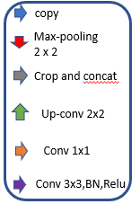
EXPANSION PATH (DECODER)
Significant advantage of this architecture lies in expansion or decoder section. Each block takes in the up-sampled input from the previous layer and concatenates with the corresponding output features from the res-blocks in the contraction path. This is then again passed through the res-block followed by 2x2 up-sampling convolution layers.
This helps to ensure that features learned while contracting are used while reconstructing the image.
Finally in the last layer of expansion path, the output from the res-block is passed through 1x1 convolution layer to produce the desired output with the same size as the input.
RESUNET ARCHITECTURE:
CONTRACTION PATH (ENCODER)
The contraction path consist of several contraction blocks, each block takes an input that passes through res-blocks followed by 2x2 max pooling. Feature maps after each block doubles, which helps the model learn complex features effectively.
BOTTLENECK
The bottleneck block, serves as a connection between contraction path and expansion path.
The block takes the input and then passes through a res-block followed by 2x2 up-sampling convolution layers.

Slide 13
RESUNET ARCHITECTURE:
1. Encoder or contracting path consist of 4 blocks:
First block consists of 3x3 convolution layer + Relu + Batch-Normalization
Remaining three blocks consist of Res-blocks followed by Max-pooling 2x2.
2. Bottleneck:
It is in-between the contracting and expanding path.
It consist of Res-block followed by up sampling conv layer 2x2.
3. Expanding or Decoder path consist of 4 blocks:
3 blocks following bottleneck consist of Res-blocks followed by up-sampling conv layer 2 x 2
Final block consist of Res-block followed by 1x1 conv layer.

Slide 14
RESUNET ARCHITECTURE:
Res-block
Res-block
Res-block
Res-block
Res-block
copy
Max-pooling 2 x 2
Res-block
Res-block
Crop and concat
Up-conv 2x2
Res-block
Conv 1x1
Conv 3x3,BN,Relu

Slide 15
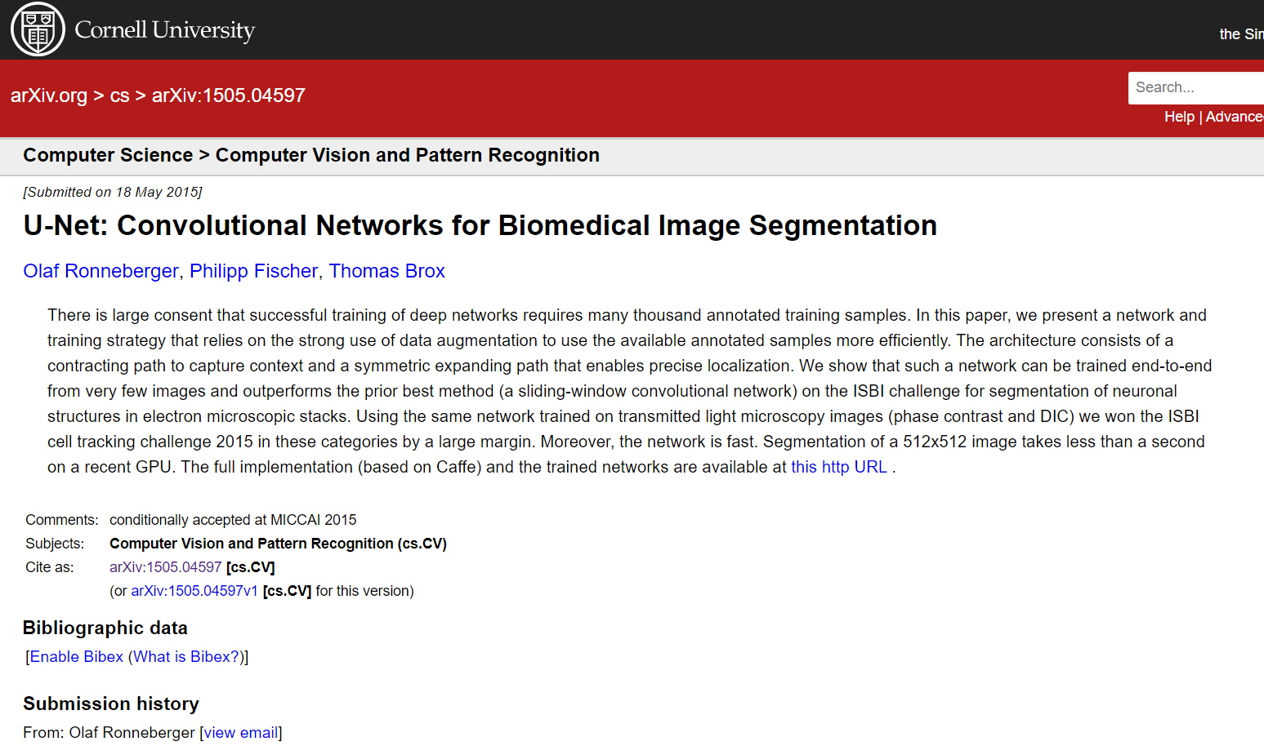
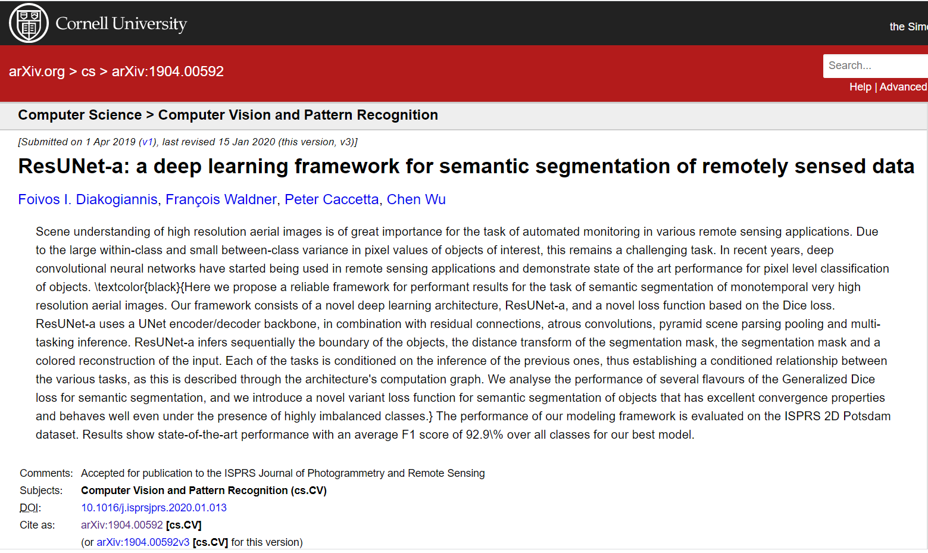
RESUNET ADDITIONAL RESOURCES:
Paper #1: https://arxiv.org/abs/1505.04597
Paper #2: https://arxiv.org/abs/1904.00592
Great article: https://towardsdatascience.com/introduction-to-u-net-and-res-net-for-image-segmentation-9afcb432ee2f

Slide 16
MASK:
The goal of image segmentation is to understand the image at the pixel level. It associates each pixel with a certain class. The output produce by image segmentation model is called a “mask” of the image.
Masks can be represented by associating pixel values with their coordinates. For example if we have a black image of shape (2,2), this can be represented as:
[[ 0, 0],
[0, 0]]
If our output mask is as follows:
[[255, 0],
[0,255]]
To represent this mask we have to first flatten the image into a 1-D array. This would result in something like [255,0,0,255] for mask. Then, we can use the index to create the mask. Finally we would have something like [1,0,0,1] as our mask.

Slide 17
RUN LENGTH ENCODING (RLE):
Sometimes it is hard to represent mask using index as it would make the length of mask equal to product of height and width of the image
To overcome this we use lossless data compression technique called Run-length encoding (RLE), which stores sequences that contain many consecutive data elements as a single data value followed by the count.
For example, assume we have an image (single row) containing plain black text on a solid white background. B represents black pixel and W represents white:
WWWWWWWWWWWWBWWWWWWWWWWWWBBBWWWWWWWWWWWWWWWWWWWWWWWWBWWWWWWWWWWWWWW
Run-length encoding (RLE):
12W1B12W3B24W1B14W
This can be interpreted as a sequence of twelve Ws, one B, twelve Ws, three Bs, etc.,

